Slide 1

- Mid-term Presentation -

Slide 2
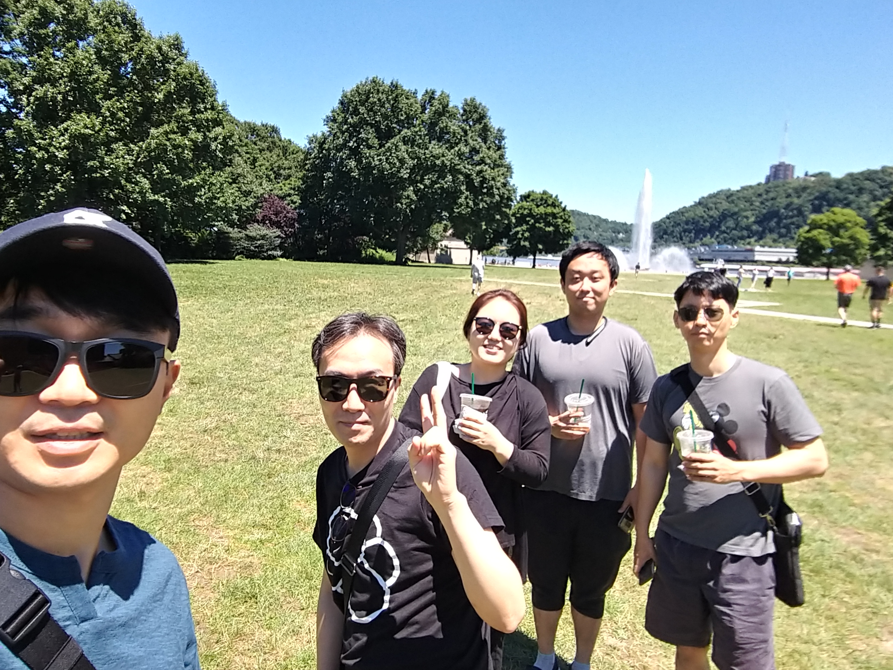
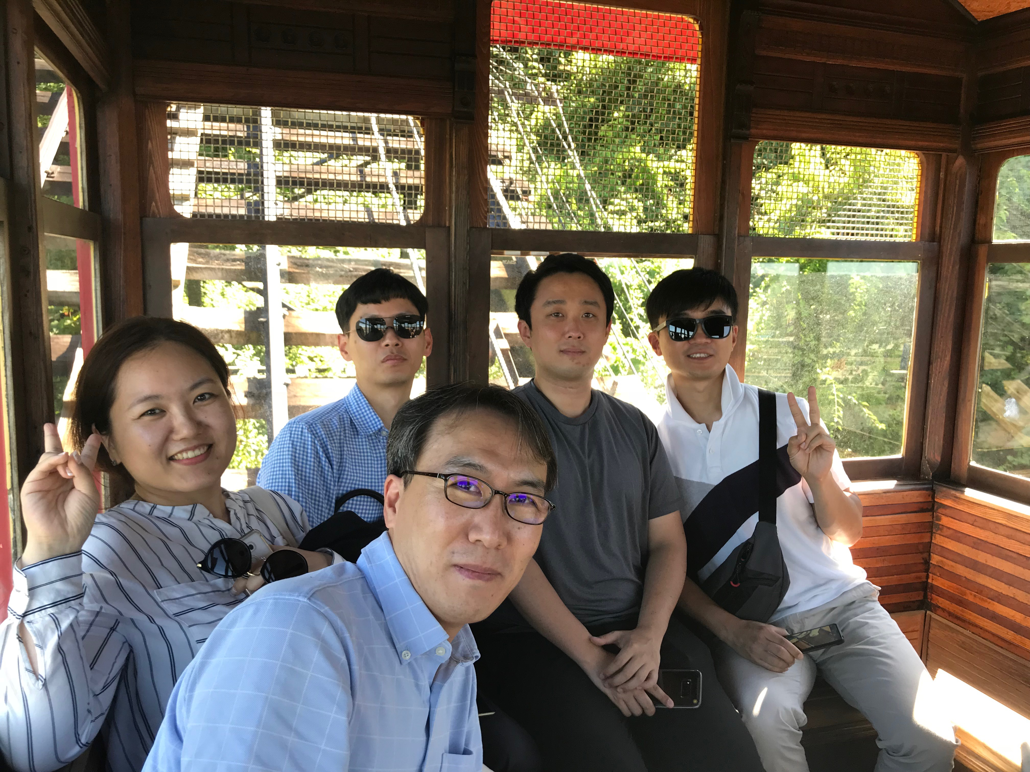
Team introductions
Team members (main role)
Sungho Chin (Team & Project Lead)
Jonggu Lee (Code Review Lead)
Sujung Lyu (Refactoring Lead)
Jinhyuk Yang (Static Analysis Lead)
Hyoyeon Hwang (Plan & Test Lead)
Team Goal :
“Studying and Understanding of SDET Culture and Techniques”, not dancing or singing!!
Team Process :
Every member should be involved in every quality management process.
5 hrs for project / day, 1 project / day, 1 mentoring meeting / week

Slide 3
Project introductions
Project Goal
“Tracking bugs and defects until our customer(jeff) is satisfied.”
Quality Goals
Testability : line coverage : 90%, branch coverage : 80%, mutation coverage : 90%
Functional correctness : unit test - pass 100%
Functional suitability for new features : 60%
Usability (optional) : improve game command and message visibility (can be play the game with the less use ‘help’ command)

Slide 4
Project Plan

Slide 5
Tools
CI : Github + Jenkins (http://40.74.87.221:8080)+ sonaQube
Source repository : github (https://github.com/sunghochin/TartanAdventure)
Quality Tool : SonarQube (http://40.74.87.211:9000/projects)
document configuration : wiki page (https://sdet-bts.atlassian.net/wiki/spaces/SDET/overview)
issue tracker : jira (https://sdet-bts.atlassian.net/secure/RapidBoard.jspa?projectKey=SDET&rapidView=1)
Coverage library : jacoco, pitest
Auto trigger build
Static analysis
build
Coverage integration
source commit
Measure coverage

